Slide 1

Introduction
From 2021 to 2022, there were 948,312 hospital admissions and 20,970 deaths (Office for Health Improvement & Disparities, 2023)
An estimated 9 million adults are at risk(Sheeraz, 2019)
Address health disparities and social determinants of health(Collis et al., 2010; Office for National Statistics, 2019)
Health Survey for England, 2011 dataset
Notes:
Reference:
Collis, J., Grayson, A. and Johal, S., 2010. Econometric analysis of alcohol consumption in the UK. London: HM Revenue & Customs.
Rajput, S.A., Aziz, M.O. and Siddiqui, M.A., 2019. Social determinants of Health and Alcohol consumption in the UK. Epidemiology, Biostatistics, and Public Health, 16(3).
Office for Health Improvement & Disparities, 2023. Local Alcohol Profiles for England: short statistical commentary. Available at https://www.gov.uk/government/statistics/local-alcohol-profiles-for-england-lape-march-2023-update/local-alcohol-profiles-for-england-short-statistical-commentary-march-2023. Accessed [Feb, 2024]

Slide 2
Types of analyses performed
Descriptive analysis
Comparative analysis
Correlation

Slide 3
Why R?
R is highly versatile and powerful
Extensive package ecosystem
Strong community support
Notes:
Kabacoff, R., 2022. R in action: data analysis and graphics with R and Tidyverse. Simon and Schuster.

Slide 4
Descriptive Statistics
a. How many people are included in the sample? | Total Sample | 10617
b. What is the percentage of people who drink alcohol? | % of people drink alcohol | 6712 (63.2%)
c. What is the percentage of women in the sample? | % of women in the sample | 5765 (54.3%)
d. What is the highest educational level? | Highest educational level- | NVQ4/NVQ5/Degree
e. What is percentage of divorced and separated people? | Divorced Separated | 594 (5.6%) 224 (2%)

Slide 5
Summary
In a sample of 10,617 individuals, 6,712 (63.2%) reported drinking alcohol
Among them, 5,765 (54.3%) were women
The majority had obtained an degree equivalent as their highest level of education.
Additionally, there were 594 (5.6%) individuals who were divorced and 224 (2%) who were separated.

Slide 6
Find the mean, median, mode, minimum, maximum, range and standard deviation of household size, BMI and age at last birthday
 | Household size | BMI | Age at last birthday
Mean | 2.9 | 25.9 | 41.6
Median | 3 | 25.6 | 42
Mode | 3 | 21 | 3
Minimum | 1 | 8.3 | 0
Maximum | 10 | 65.3 | 100
Range | 9 | 56.9 | 100
Standard deviation | 1.37 | 6.1 | 23.8

Slide 7
Summary
Household Size:
• 2.85 individuals
• variability of approximately 1.37
• The minimum household size is 1
Body Mass Index:
• The mean BMI is approximately 25.92
• There is variability 6.14
• The range from 8.34 to 65.28
Age:
• The mean age is 41.56 years.
• The standard deviation of approximately 23.83
• The age values range from 0 to 100

Slide 8
Inferential Statistics
a. Run a significance test to find out which gender drinks more alcohol
 | Drinking Status |  | Value of the test and p value
Gender | Yes N (%) | No N (%) | Chi-square = 114.15 P-value = 2.2e-16
Male | 3172 (37.16%) | 605 (7.1%)
Female | 3540(41.48%) | 1217 (14.26%)

Slide 9
Summary
The null hypothesis (H0) is that there is no difference in alcohol consumption between genders
The Alternative hypothesis (HA) is that there is difference in consumption between genders
317 2 males, yes
605 males, no
3540 females, yes
1217, no
p-value (2.2e-16)
we reject the null hypothesis

Slide 10
b. Run a significance test to find out which region drinks the most alcohol.
 | Drinking Status |  | Value of the test and p value
Region | Yes | No | Chi-square = 979.74 P-value = 0.0004998
White - English/Welsh/Scottish/Northern Irish/British | 5925 (69.5%) | 1219 (14.3%)
White - Irish | 62 (0.72%) | 15 (0.17%)
White - Gypsy or Irish Traveler | 2 (0.02%) | 1 (0.01%)
Any other white background | 326 (3.82%) | 88 (1%)
White and Black Caribbean | 23 (0.26%) | 3 (0.03%)
White and Black African | 8 (0.09%) | 2 (0.02%)
White and Asian | 17 (0.2%) | 13 (0.15%)
Any other mixed/multiple ethnic background | 18 (0.2%) | 13 (0.15%)
Indian | 100 (1.17%) | 105 (1.23%)
Pakistani | 6 (0.1%) | 134 (1.6%)
Bangladeshi | 5 (0.06%) | 41 (0.48%
Chinese | 26 (0.3%) | 8 (0.1%)
Any other Asian background | 52 (0.6%) | 45 (0.5%)
African | 46 (0.5%) | 72 (0.8%)
Caribbean | 53 (0.6%) | 25 (0.3%)
Any other Black/African/Caribbean background | 18 (0.2%) | 4 (0.05%)
Arab | 4 (0.05%) | 17 (0.2%)
Any other ethnic group (please describe) | 11 (0.12%) | 15 (0.17%)

Slide 11
Summary
The null hypothesis (H0) is that there is no difference in alcohol consumption between regions
The Alternative hypothesis (HA) is that there is difference in consumption between regions
p-value (0.0004998) which is less than 0.05
we reject the null hypothesis

Slide 12
c. Investigate whether there is a statistical difference between men and women on the following variables:
Valid height.
Valid weight.

Slide 13
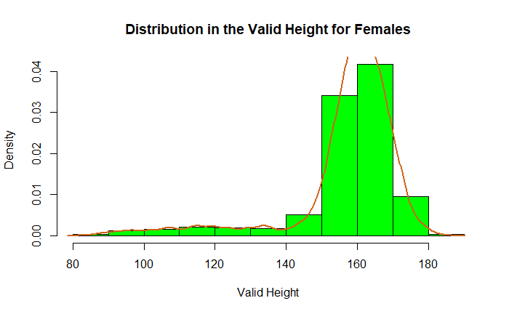
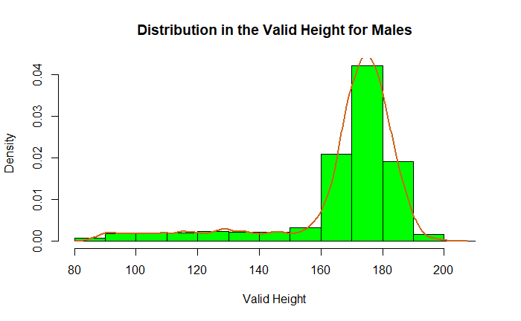
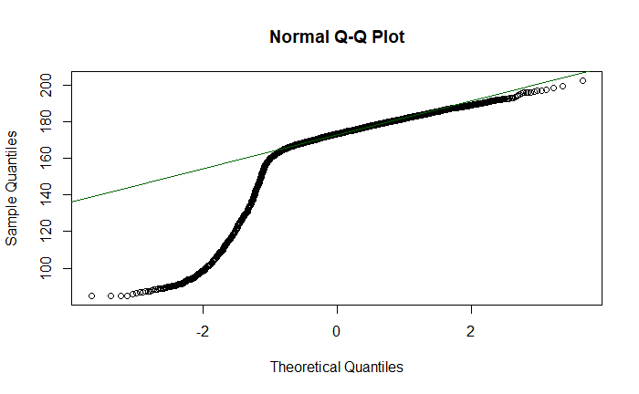
check for normal distribution in the height data
Shapiro-Wilk normality test
data: males_data$htval
W = 0.73755, p-value < 2.2e-16

Slide 14
i. Valid height
The Shapiro-Wilk normality test p-value for height is 2.2e-16
data does not follow a normal
Null Hypothesis (H0): There is no difference in height between men and women.
Alternative Hypothesis (H1): There is a difference in height between men and women.

Slide 15
Summary
wilcox.test(htval ~ Sex, data = height_weight)
Wilcoxon rank sum test with continuity correction
data: htval by Sex W = 14713021, p-value < 2.2e-16 alternative hypothesis: true location shift is not equal to 0
The p-value is less than 0.05
we reject the null hypothesis

Slide 16
Investigate whether there is a statistical difference between men and women on the following variables: i. Valid weight
Null Hypothesis (H0): There is no difference in weight between men and women.
Alternative Hypothesis (H1): There is a difference in weight between men and women.

Slide 17
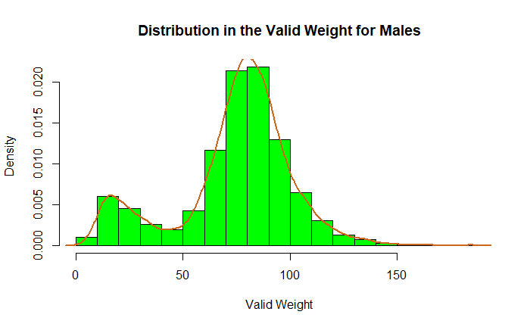
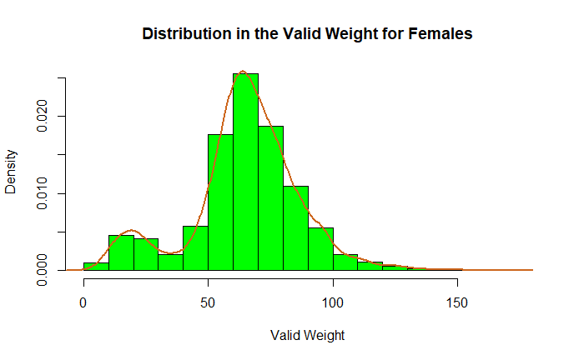
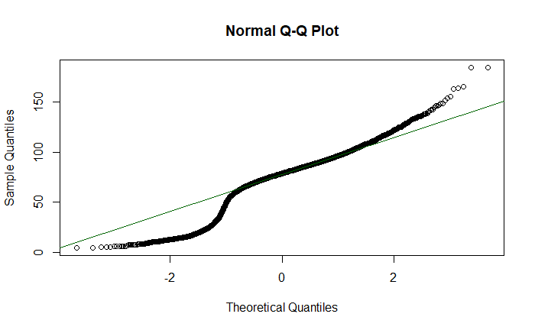
check for normal distribution in the weight data
Shapiro-Wilk normality test
data: males_data$wtval
W = 0.93674, p-value < 2.2e-16

Slide 18
Wilcoxon rank sum test with continuity correction data: wtval by Sex W = 12449400, p-value < 2.2e-16 alternative hypothesis: true location shift is not equal to 0
The p-value 0.05
we reject the null hypothesis

Slide 19
What is the correlation between whether a person drinks nowadays, total household income, age at last birthday and gender?
 | Drink now a days | Total household income | Age at last birthday | Gender
Drink now a days |  | r=-0.15 p-value <2.2e-16 | r=0.06 p-value = 1.871e-10 | r=0.11 p-value < 2.2e-16
Total household income | r=-0.15 p-value <2.2e-16 |  | r=-0.04 p-value = 1.125e-05 | r=-0.04 p-value = 2.172e-05
Age at last birthday | r=0.06 p-value = 1.871e-10 | r=-0.04 p-value = 1.125e-05 |  | r=0.032 p-value = 0.0007558
Gender | r=0.11 p-value < 2.2e-16 | r=-0.04 p-value = 2.172e-05 | r=0.032 p-value = 0.0007558

Slide 20
Correlation summary
• drinks now days and total household income
Spearman correlation coefficient is -0.15, weak negative
• drinks now days and age at last birthday
Spearman correlation coefficient is 0.06 , weak positive
• drinks now days and gender
Spearman correlation coefficient is -0.11 , weak negative
• household income and age at last birthday
Spearman correlation coefficient is -0.04 , weak negative
• total household income and gender
Spearman correlation coefficient is -0.04, weak
• age at last birthday and gender
Spearman correlation coefficient is 0.032, weak positive
.

Slide 21
A discussion of findings with reference to relevant literature on gender and alcohol in the UK
Reductions in alcohol consumption rates among men(Meier et al.,2021)
Rise in alcohol consumption among women (Arsalan et al.,2016)
Alcohol consumption gap is narrowing by sex (Davoren et al. (2016)
Literature & our research findings are consistent
Notes:
Moinuddin, A., Goel, A., Saini, S., Bajpai, A. and Misra, R., 2016. Alcohol consumption and gender: a critical review. J Psychol Psychother, 6(3), pp.1-4.
Davoren, M.P., Demant, J., Shiely, F. and Perry, I.J., 2016. Alcohol consumption among university students in Ireland and the United Kingdom from 2002 to 2014: a systematic review. BMC public health, 16(1), pp.1-13.
Meier, P.S., Holmes, J., Brennan, A. and Angus, C., 2021. Alcohol policy and gender: a modelling study estimating gender‐specific effects of alcohol pricing policies. Addiction, 116(9), pp.2372-2384.

Slide 22
Conclusion
There are gender differences in alcohol consumption patterns.
The gender gap in alcohol consumption has been narrowing over time (Meier et al.,2021).
Recommendation
Further research and evidence-based interventions are needed
Address relationship between gender and alcohol consumption
Mitigate associated health risks.
Public health efforts should focus on raising awareness
Combat rising trend of alcohol consumption among women (Fitzgerald et al., 2016).
Notes:
Fitzgerald, N., Angus, K., Emslie, C., Shipton, D. and Bauld, L., 2016. Gender differences in the impact of population‐level alcohol policy interventions: evidence synthesis of systematic reviews. Addiction, 111(10), pp.1735-1747.

Slide 23
References
Collis, J., Grayson, A. and Johal, S., 2010. Econometric analysis of alcohol consumption in the UK. London: HM Revenue & Customs.
Rajput, S.A., Aziz, M.O. and Siddiqui, M.A., 2019. Social determinants of Health and Alcohol consumption in the UK. Epidemiology, Biostatistics, and Public Health, 16(3).
Office for Health Improvement & Disparities, 2023. Local Alcohol Profiles for England: short statistical commentary. Available at https://www.gov.uk/government/statistics/local-alcohol-profiles-for-england-lape-march-2023-update/local-alcohol-profiles-for-england-short-statistical-commentary-march-2023. Accessed [Feb, 2024]
Kabacoff, R., 2022. R in action: data analysis and graphics with R and Tidyverse. Simon and Schuster.
Moinuddin, A., Goel, A., Saini, S., Bajpai, A. and Misra, R., 2016. Alcohol consumption and gender: a critical review. J Psychol Psychother, 6(3), pp.1-4.
Davoren, M.P., Demant, J., Shiely, F. and Perry, I.J., 2016. Alcohol consumption among university students in Ireland and the United Kingdom from 2002 to 2014: a systematic review. BMC public health, 16(1), pp.1-13.
Meier, P.S., Holmes, J., Brennan, A. and Angus, C., 2021. Alcohol policy and gender: a modelling study estimating gender‐specific effects of alcohol pricing policies. Addiction, 116(9), pp.2372-2384.
Fitzgerald, N., Angus, K., Emslie, C., Shipton, D. and Bauld, L., 2016. Gender differences in the impact of population‐level alcohol policy interventions: evidence synthesis of systematic reviews. Addiction, 111(10), pp.1735-1747.

Slide 24
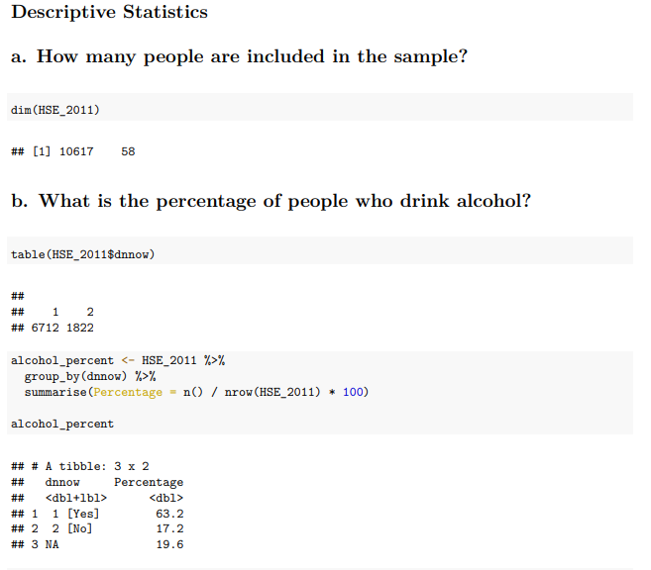
Appendix 1
Descriptive Statistics

Slide 25
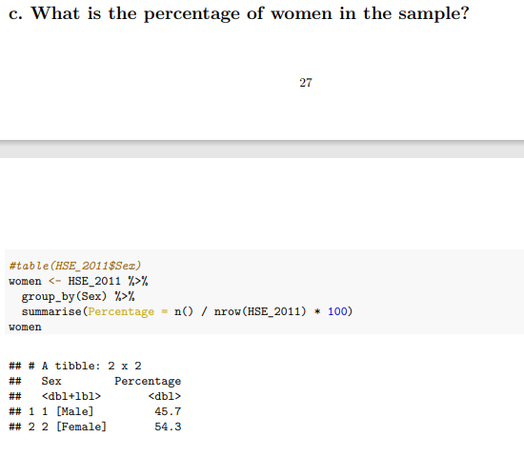
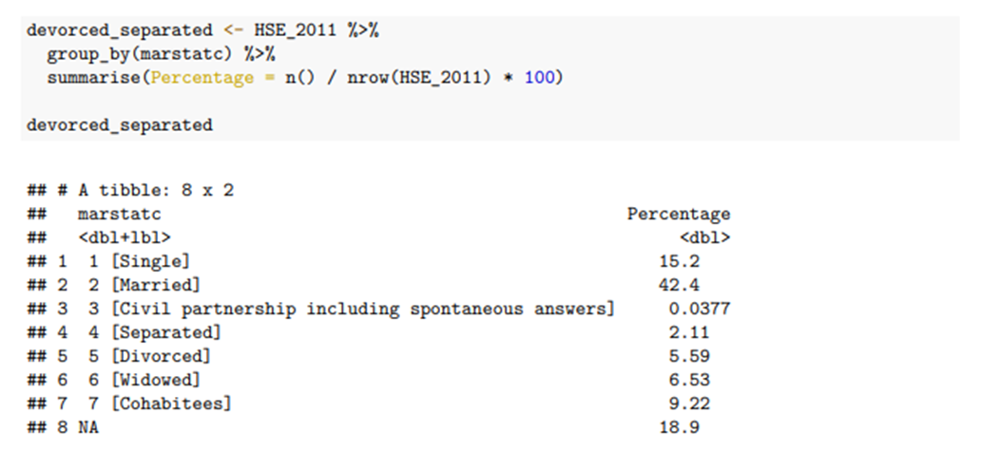

Slide 26
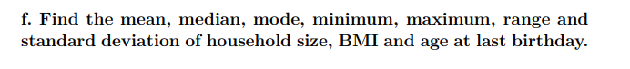
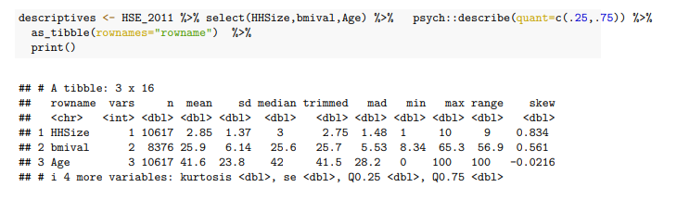
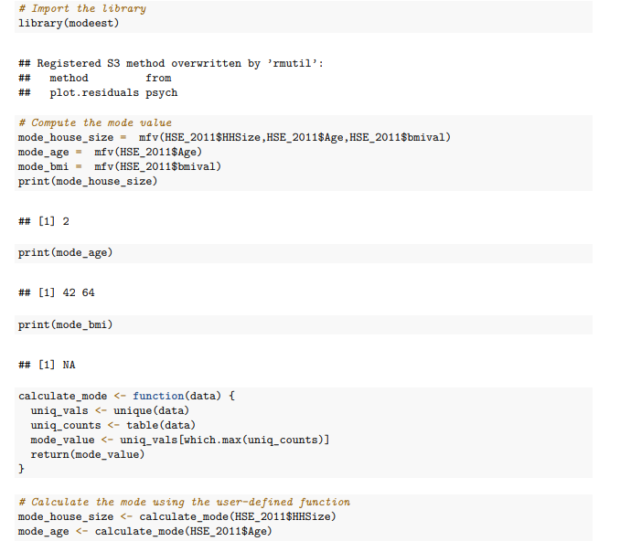

Slide 27
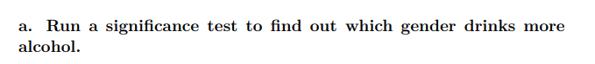
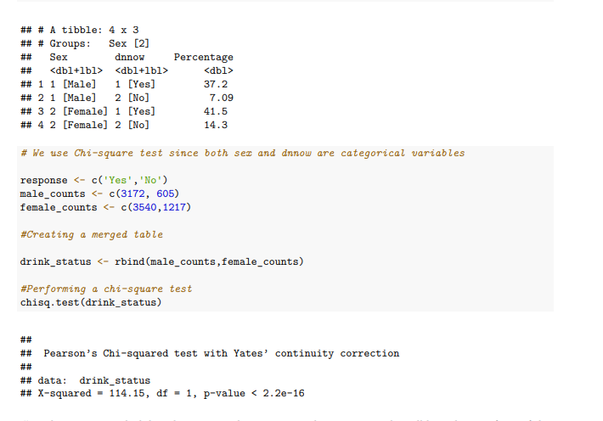
Appendix 2
Chi-square

Slide 28
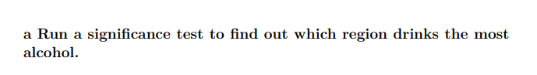
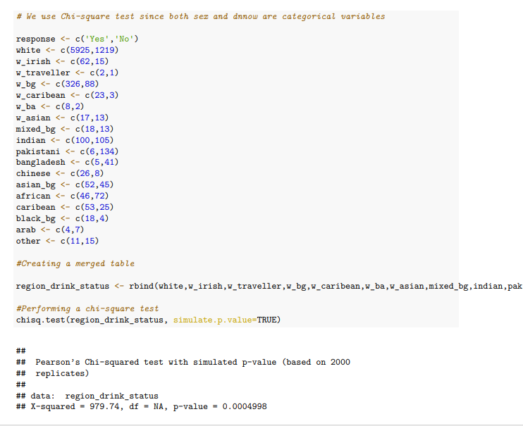

Slide 29
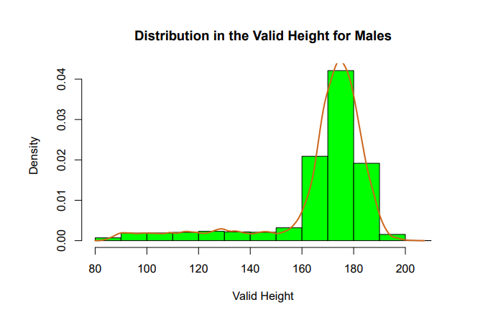
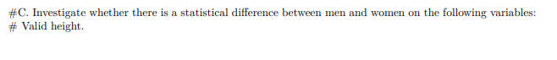
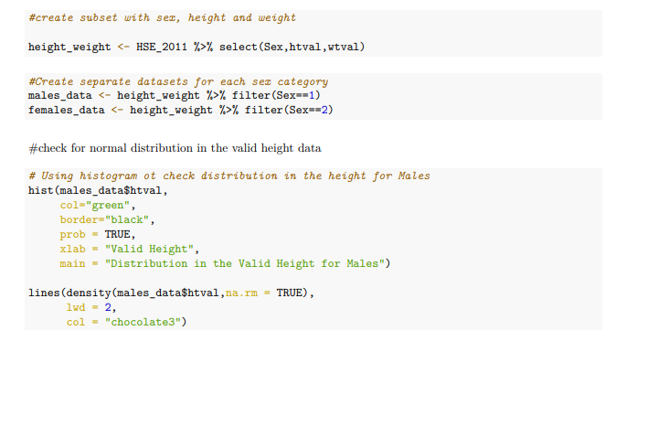
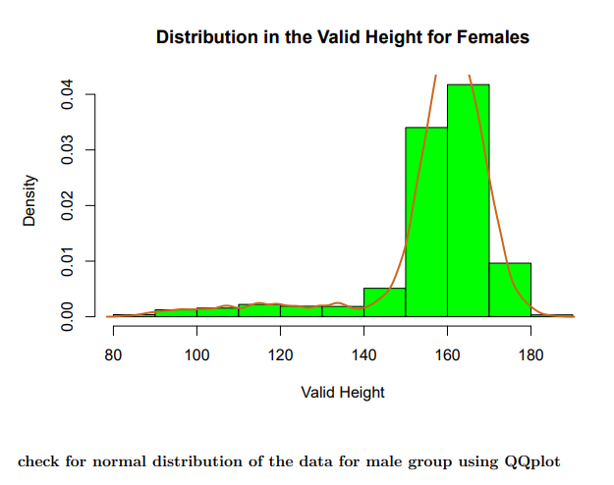
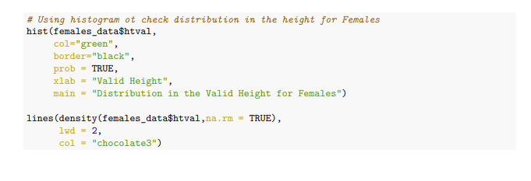
Appendix 3 Normality Test and Mann-whitney U test

Slide 30
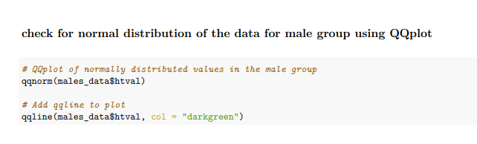
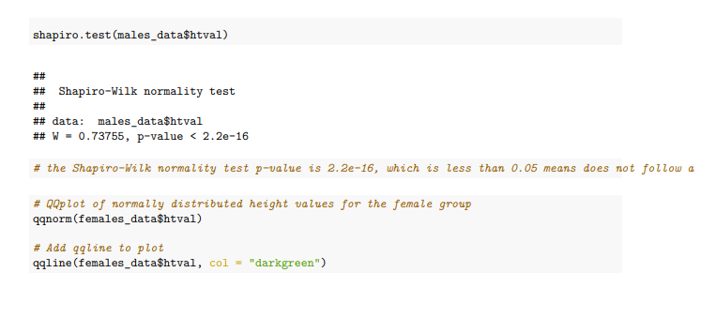
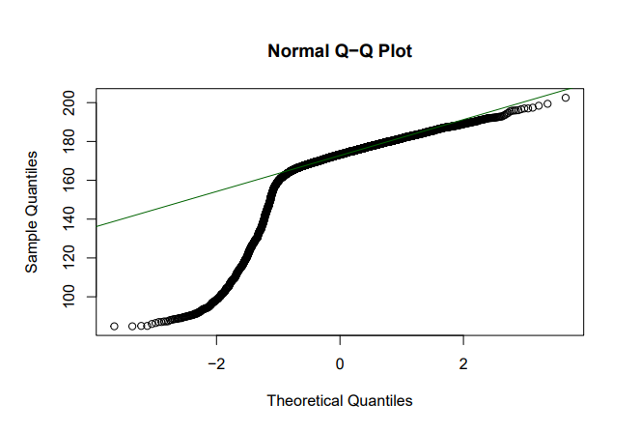

Slide 31
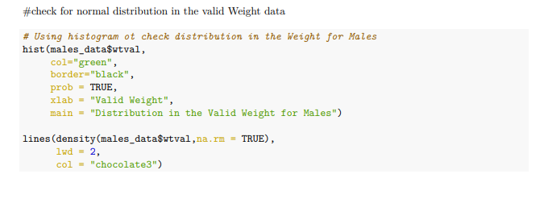
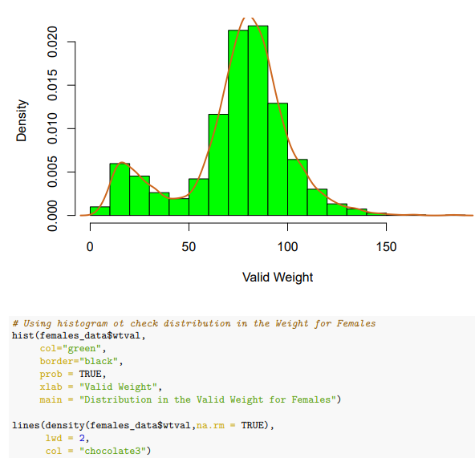
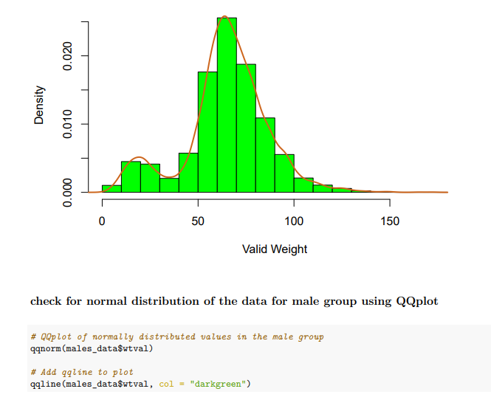

Slide 32
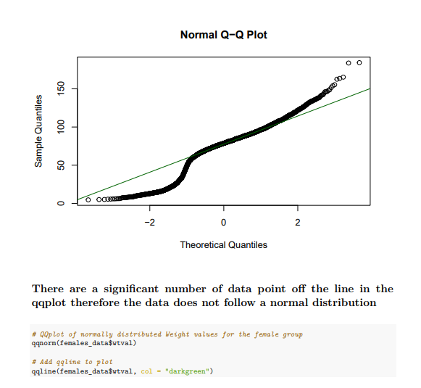
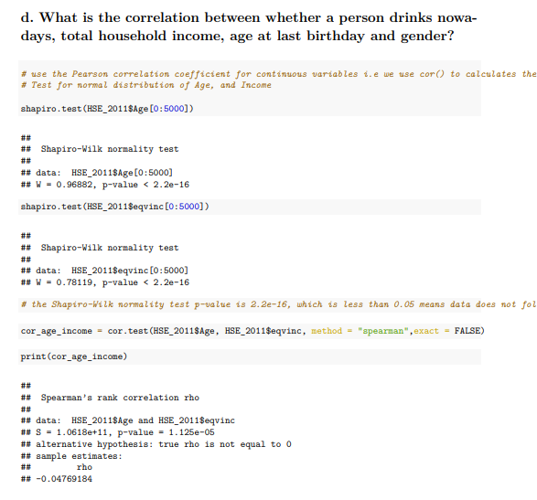

Slide 33
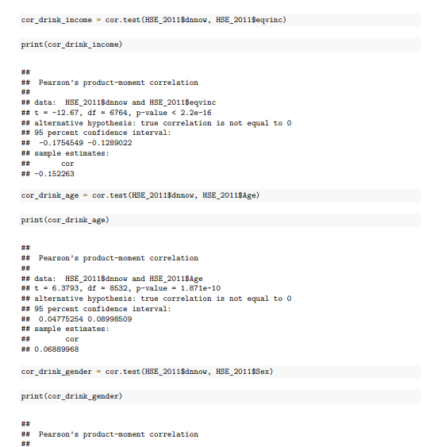
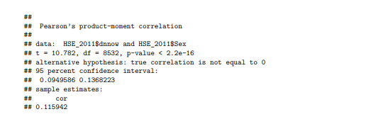
Appendix 4 Correlation

Slide 34
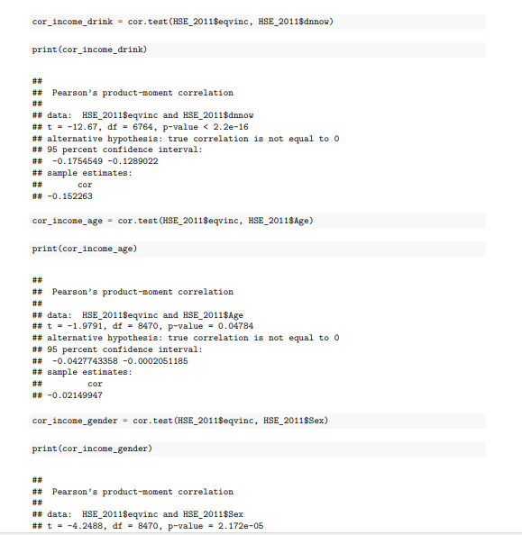
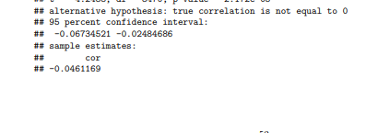

Slide 35
